Slide 1
AutoDock 4.2.6 installation on Windows
AutoDock 4 and AutoGrid 4 are free software, distributed under the GNU General Public License. The C and C++ source code of all the programs is provided, along with ready-to-run executables for several popular computers.
AutoDock and AutoGrid run natively under Windows, hence there is no requirement for Cygwin anymore.
By default, the programs will be installed in the Program Files directory (i.e. C:\Program Files\The Scripps Research Institute\Autodock). To test the installation, go to Start->Run... and type "cmd.exe". At the Windows prompt, type the command "C:\Program Files\The Scripps Research Institute\Autodock\autodock4.exe" and if installation succeeded the terminal should report the following lines:
C:\Users\mgl>"C:\Program Files\The Scripps Research Institute\Autodock"\autodock4.exe
usage: AutoDock -p parameter_filename
-l log_filename
-k (Keep original residue numbers)
-i (Ignore header-checking)
-t (Parse the PDBQT file to check torsions, then stop.)
-d (Increment debug level)
-C (Print copyright notice)
--version (Print autodock version)
--help (Display this message)

Slide 2
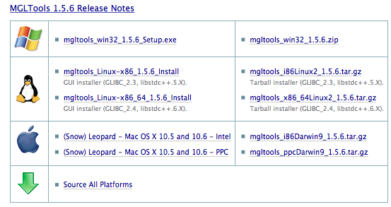
MGLTools 1.5.6

